Slide 1
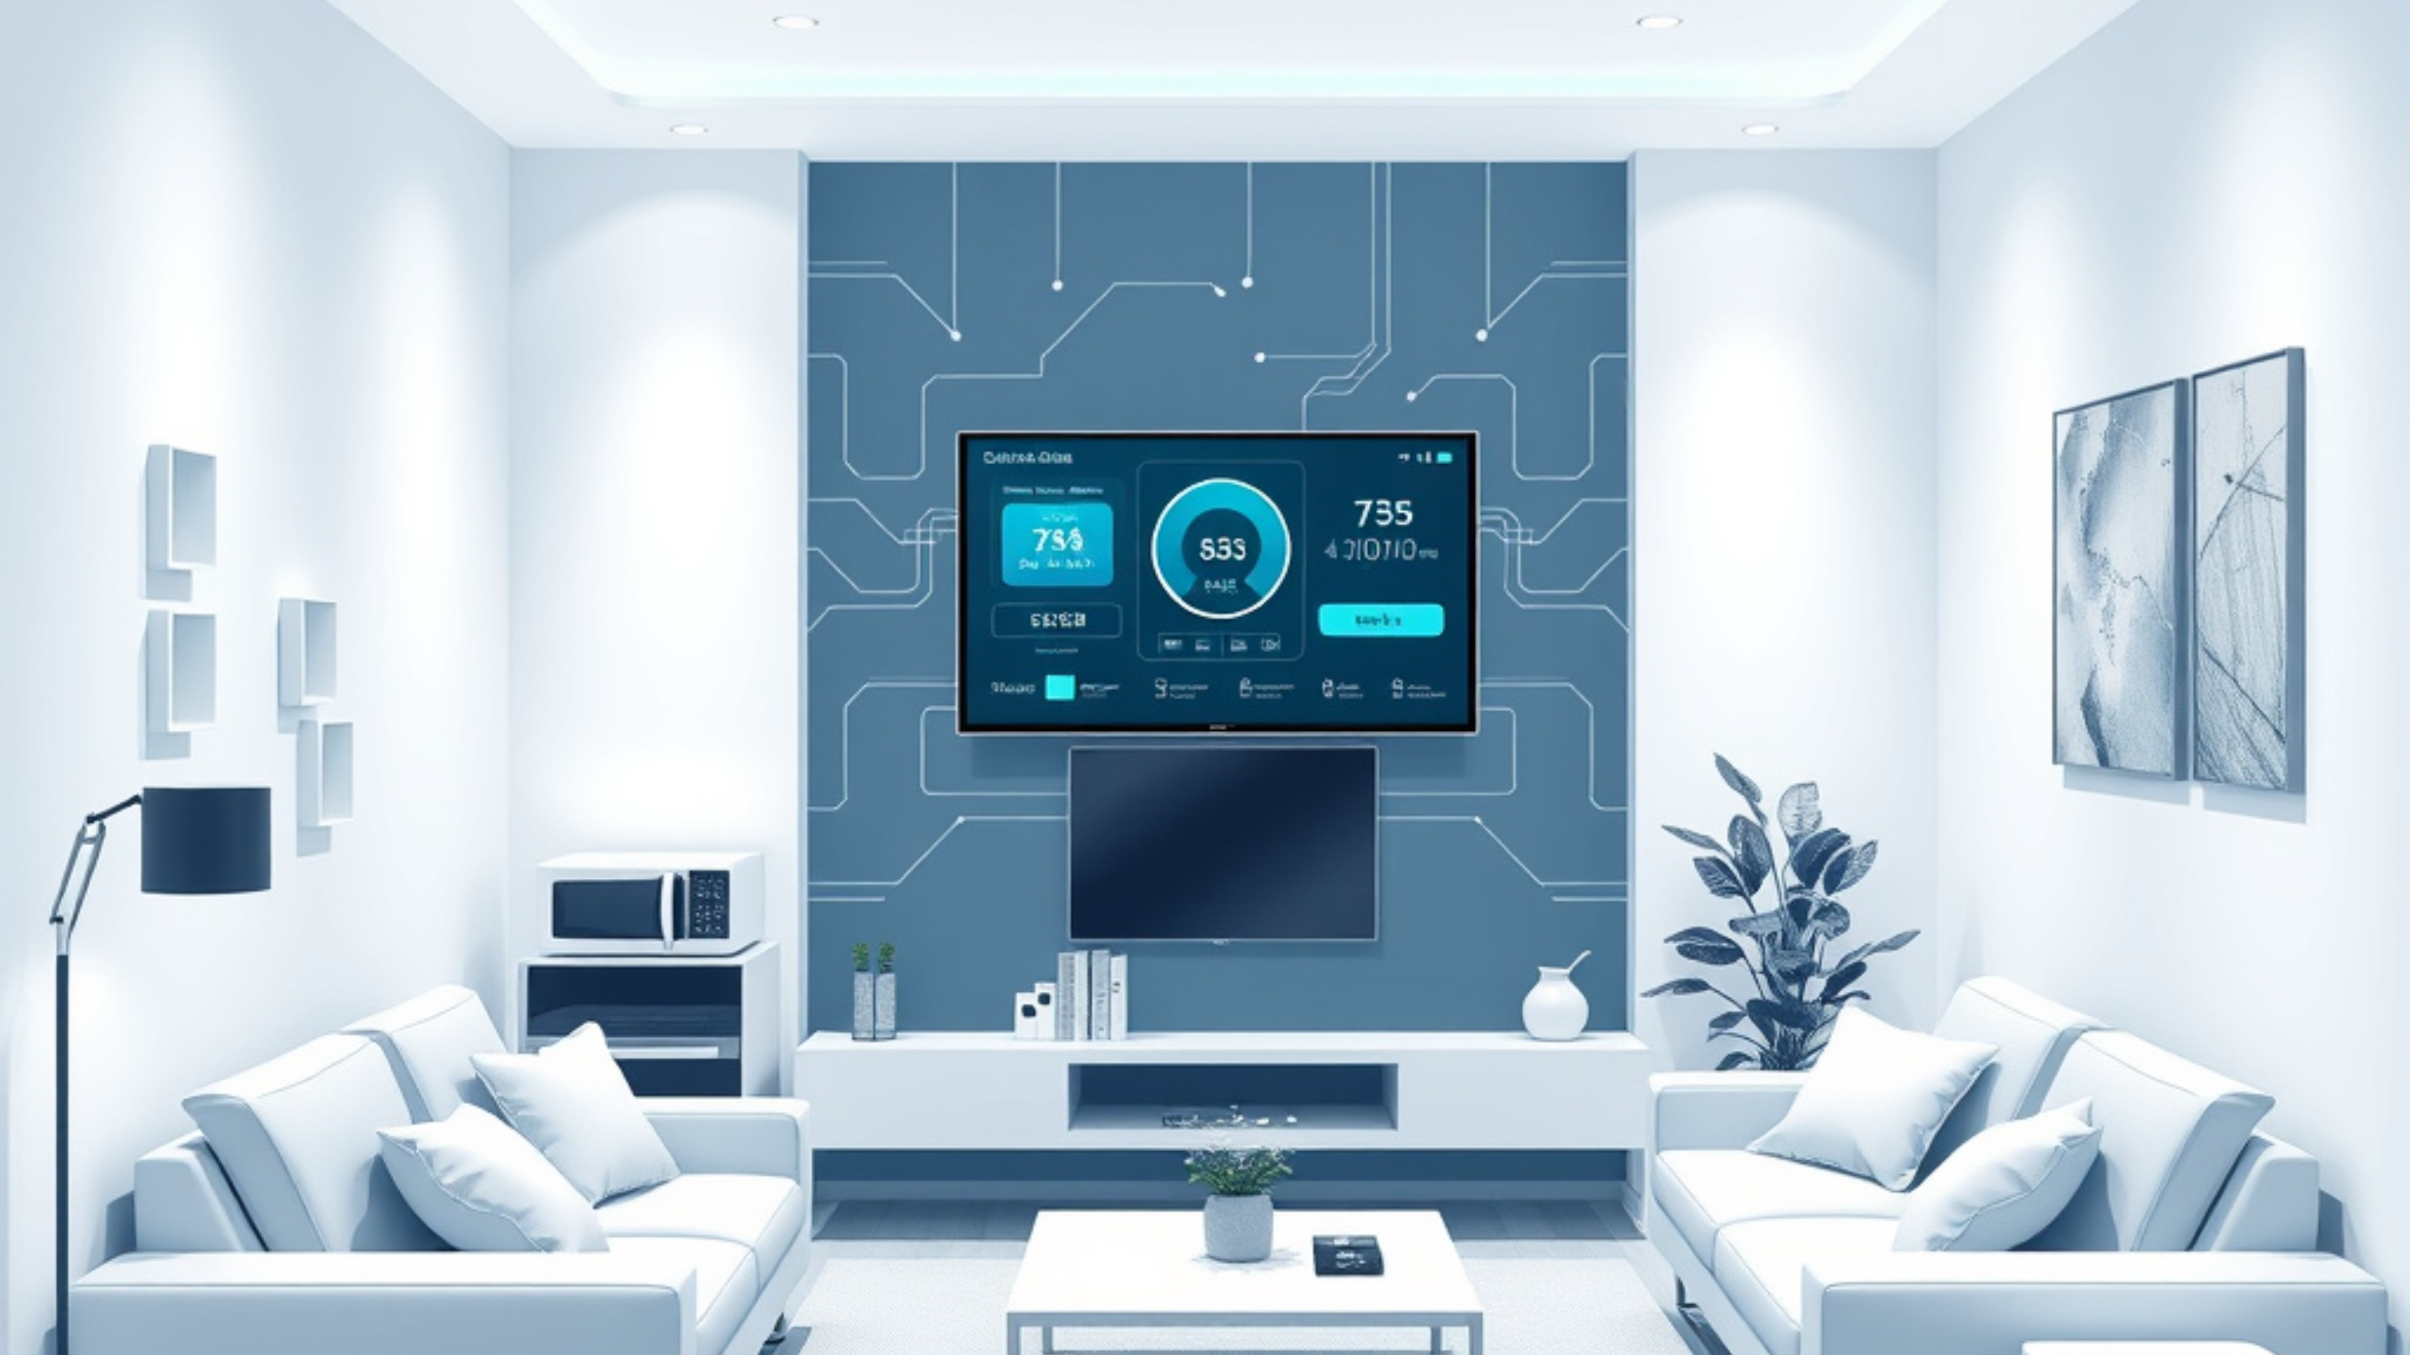

CAPSTONE PROJECT
IoT-Based Energy-Efficient Home Appliance Automation Hub
Intelligent control for connected appliances, designed to reduce waste and simplify everyday living.
Mohammed Haneef
1925260004
Mohammed Farmanullah
1972226040
Kavin JG
1924260105
SMART HOME AUTOMATION HUB

Slide 2




AGENDA
Structured flow for the engineering review
From the problem context to the implementation results, this presentation follows the full system story.
Problem statement
Objectives and scope
Define the pain point, why it matters, and the motivation behind the smart-home automation hub.
Clarify what the system will achieve, the boundaries of the build, and the success criteria.
Architecture and method
Implementation and results
Walk through the module layout, signal flow, and methodology used to design the control system.
Show the build outcome, testing evidence, and the final results that support the evaluation.

Slide 3




ENGINEERING PROBLEM FRAMING
Problem Statement
Households waste energy because usage is visible only at the whole-home level, leaving control reactive instead of intelligent.
WHY THIS MATTERS
A smarter home must sense, decide, and act automatically.
Rising household electricity consumption
Demand keeps climbing, increasing the pressure to manage loads more intelligently.
Limited visibility of appliance-level usage
Without appliance-level insight, waste remains hidden and difficult to diagnose.
The solution must translate raw energy data into precise control at the appliance level.
Manual control causes energy wastage
Human intervention is too slow, inconsistent, and dependent on attention.
Visible usage
Automated intervention
The core gap is not just consumption — it is the lack of timely, appliance-aware automation.
Reduced wastage

Slide 4



Project objectives
A smart home hub that balances control, visibility, and comfort
Three pillars guide the system: build a clean IoT automation core, expose energy use in real time, and optimize routines without sacrificing comfort.
Automation hub
Energy visibility
Efficiency first
Design one intelligent control layer for lighting, appliances, and daily routines.
Monitor appliance consumption in real time to expose waste and usage patterns.
Enable remote control and scheduling that improves efficiency without reducing comfort.
Unified rules reduce manual switching
Spot high-load devices as they run
Adjust appliances from anywhere
Modular enough to expand room by room
Turn data into clearer household decisions
Automate schedules around real routines

Slide 5





FUNCTIONAL SCOPE
Scope and Functional Requirements
The system centers on appliance control, context sensing, energy logging, and a user dashboard.
Appliance switching and scheduling
SYSTEM VIEW
Direct control of connected loads with timed operation.
A single control layer connects sensing, action, and logging.
Sensor-based occupancy and environment sensing
Detect presence, temperature, and room conditions for context-aware control.
The dashboard is the operator interface, while sensors and controllers provide the feedback loop.
Energy data acquisition and logging
Capture usage data and retain a clean operating record for review.
Mobile and web access for user control
Together, these requirements define a closed-loop smart-home hub: sense, decide, act, and record.
Operational visibility across devices and events
Structured for engineering review and implementation

Slide 6
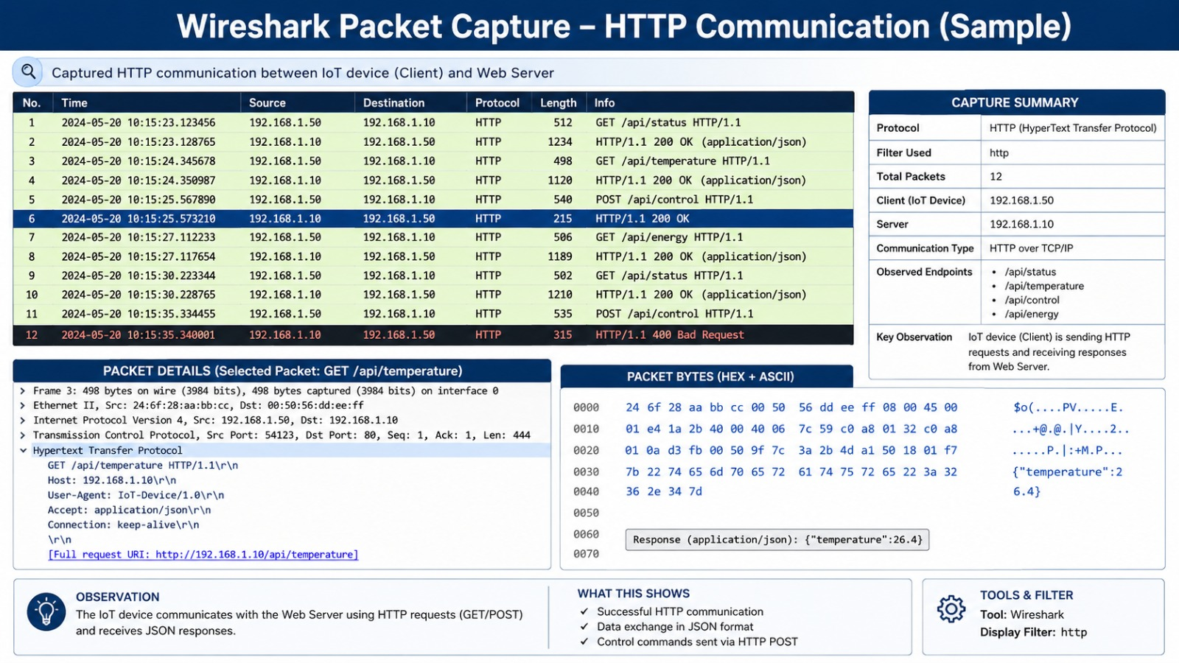

Slide 7








LITERATURE REVIEW
Existing IoT approaches reveal the gap this project addresses
A focused comparison of smart-home control, energy intelligence, and cloud-assisted automation shows where the proposed contribution becomes relevant.
Existing approaches
Gap and relevance
The literature clusters into three recurring directions:
The proposed contribution is relevant because the literature is fragmented:
IoT smart-home control frameworks
Energy-monitoring and load-forecast studies
Control, sensing, and optimization are often treated separately.
Cloud-assisted home automation approaches
Energy insight and automation are not always linked in one workflow.
Strong on individual functions, but rarely unified into one end-to-end framework.
This project positions a more integrated smart-home framework.
Verdict
The review motivates a project that connects smart-home control, energy awareness, and cloud-assisted automation in one coherent framework.

Slide 8
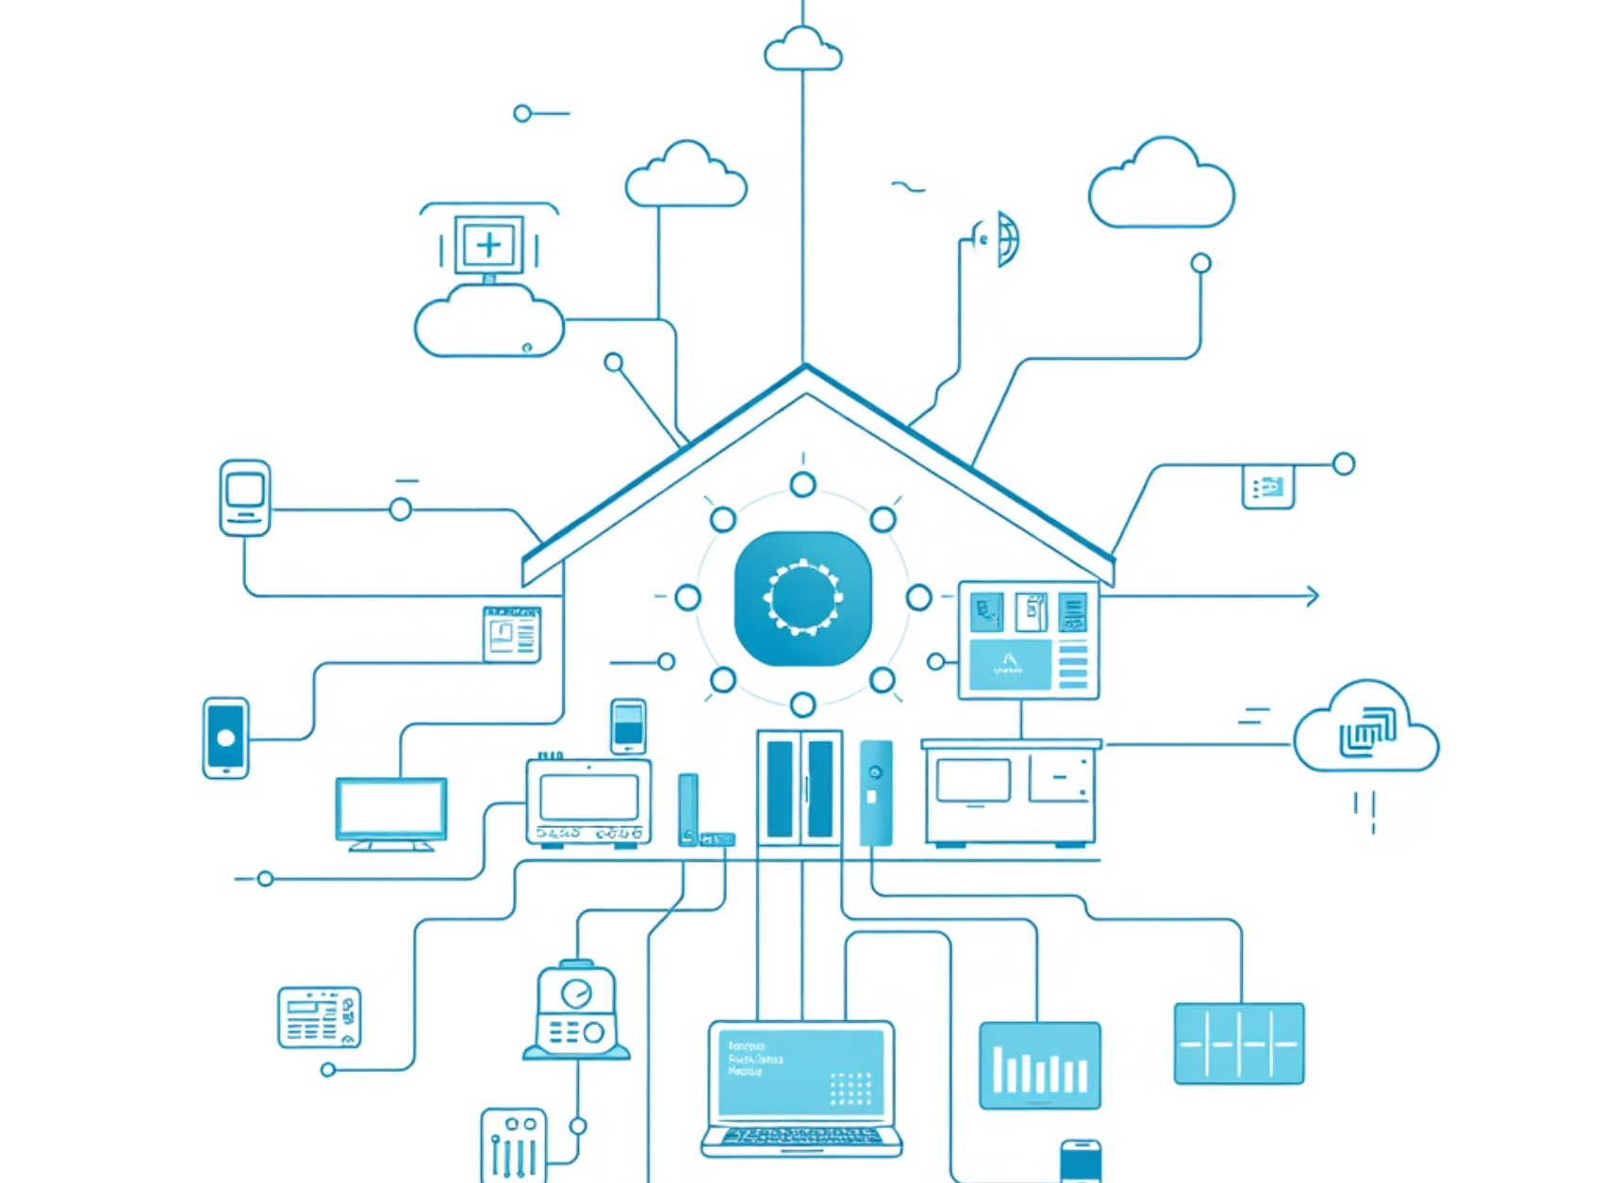




SYSTEM ARCHITECTURE
Proposed System Overview
An intelligent IoT hub connects sensing, automation, and live monitoring into one controlled home system.
SUPPORTING ARCHITECTURE
Central IoT hub
Coordinates appliances, sensors, and cloud services through one managed control path.
Sensors capture usage and environment data
Inputs from the home feed the system continuously.
Cloud dashboard visualizes real-time status
Operators see live conditions, states, and exceptions.
Rules engine triggers automation actions
Policy logic turns data into immediate responses.
The architecture emphasizes clean signal flow: sense, analyze, visualize, then act.

Slide 9



SYSTEM ARCHITECTURE
Four layers that turn home signals into action
A clean IoT control stack: sensing, processing, communication, and application stay separated for clarity and reliability.
Functional flow
Modular by design, connected in sequence
Input layer
Sensors and smart switches
Captures occupancy, command, and environmental signals at the edge of the home.
Processing layer
Microcontroller and logic
Executes rules, filters input, and makes local decisions before any network delay.
Communication layer
Wi‑Fi and cloud
Moves events to remote services for sync, logging, and system-wide visibility.
Application layer
Dashboard and alerts
Presents live status and triggers alerts that convert data into user action.

Slide 10




HARDWARE ARCHITECTURE
Hardware Components
Two blocks define the system: control electronics on one side, and sensing plus protection on the other.
Control electronics
Sensing and power
Microcontroller and relay modules
Current, occupancy, environment, protection
The microcontroller coordinates logic, timing, and device states, while relay modules provide safe switching between low-voltage control and load-side equipment.
Current and voltage sensing give feedback on load behavior, occupancy and environmental sensors capture room context, and the supply stage conditions stable power for the entire stack.
This block is the decision layer: it receives inputs, applies rules, and drives the home automation response with clean electrical isolation.
Protection circuitry keeps the system robust by handling regulation, isolation, and fault-aware operation before signals reach the controller.
Logic control for automation rules
Feedback signals from sensing circuitry
Relay isolation for mains-side safety
Protected power for reliable operation

Slide 11







SOFTWARE ARCHITECTURE
Software and Communication Stack
Embedded control on one side, data services and user access on the other — connected by stable protocols.
Embedded control
Application services
Embedded firmware for device control
Database for historical energy records
MQTT and HTTP handle data exchange
Web and mobile interface for user access
Stable protocol layer between hardware and software
Clear access layer for monitoring and interaction
Deterministic control at the device edge.
User-facing services sit above the device layer.
Verdict
Firmware controls the hardware; protocols move data; storage and interfaces turn signals into usable insight.

Slide 12
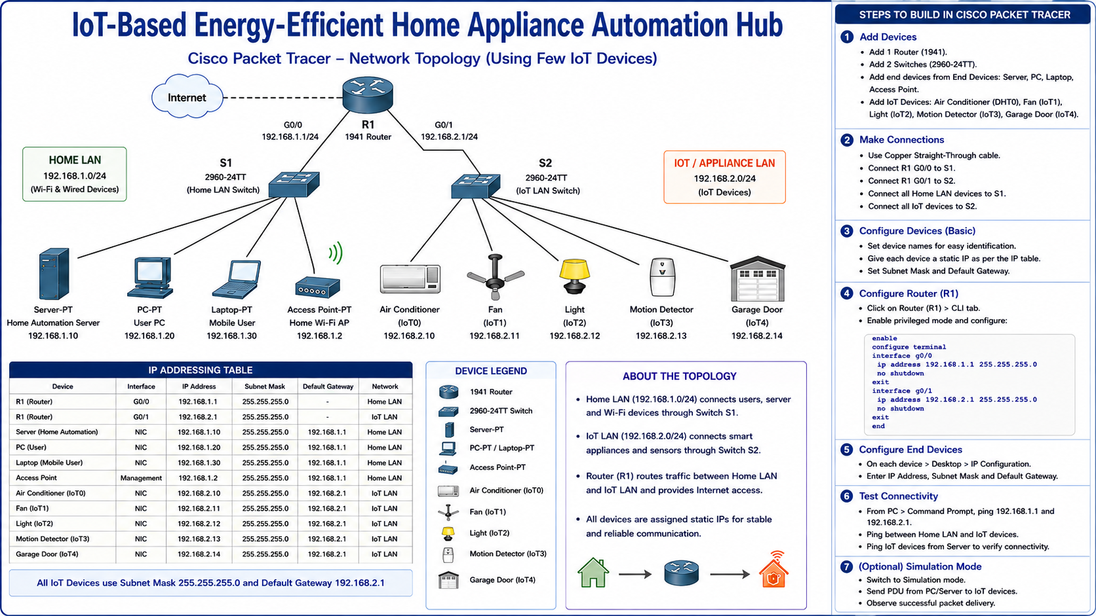

Slide 13

CONTROL LOGIC AND AUTOMATION RULES
Clear rules make the home system predictable, safe, and efficient.
Each rule is triggered by a simple signal: occupancy, time, thresholds, or user override.
SAFETY OVERRIDE
Manual control always has priority.
Occupancy-based appliance switching
If a user intervenes, the system pauses automation to protect comfort and safety.
Time-based scheduling routines
Threshold-based energy alerts
Override path remains immediate and reversible

Slide 14




ENERGY MONITORING DASHBOARD
Real-time load visibility across every circuit
Chart-centric control view for live power, appliance consumption, trend tracking, and abnormal-load alerts.
Load profile and usage trends
Live power
Live power and current signals with daily and weekly context
Real-time
Streaming status for the main feed and connected loads
Live current
Current draw compared against normal operating patterns
Alert panel
Flag abnormal load early, isolate the source, and keep the dashboard operator focused on exceptions.
Orange reserved for exceptions only

Slide 15
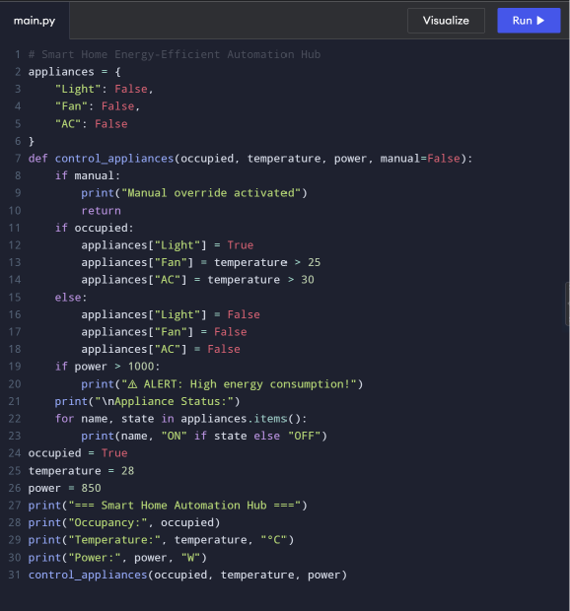
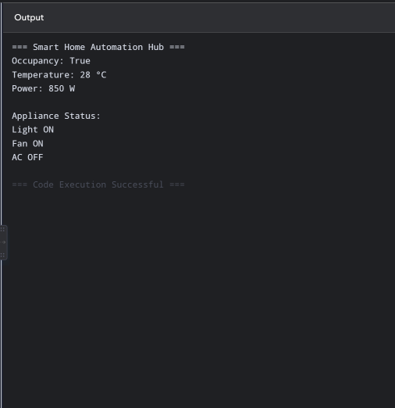
Python Source Code

Slide 16
IMPLEMENTATION WORKFLOW
From bench assembly to validated cloud publishing
A sequenced build path for the IoT home automation hub, moving from hardware bring-up to final calibration.
01
Prototype assembly and wiring
VALIDATION CHECKPOINT
Mount modules, route power, and secure sensor-to-controller connections.
Functional testing and calibration
02
Firmware development and integration
Close the loop by checking response, tuning thresholds, and confirming stable operation.
Implement device logic, then align firmware behavior with the assembled hardware.
03
Cloud setup and data publishing
Configure the backend, connect the stream, and publish live telemetry.
WORKFLOW INTENT
Each stage reduces uncertainty before the next one begins.

Slide 17
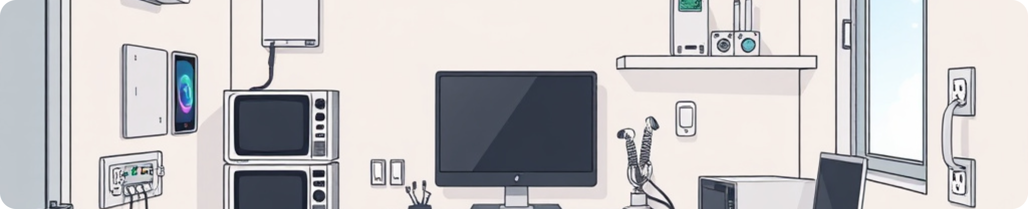

EXPERIMENTAL SETUP
Residential-room prototype with controlled appliance trials
A repeatable test environment built to compare normal, idle, and peak-load behavior under the same room conditions.
Residential-room prototype environment
A controlled setting that mirrors household use while keeping conditions consistent across trials.
Test conditions
FOCUS
Residential-room prototype
One environment, repeated conditions, comparable results.
The experiment was run in a controlled room configured to reflect home-use conditions.
Selected appliances under test
Controlled room
Each appliance was evaluated individually to isolate operating behavior and load response.
Prototype environment closely matching a residential setting.
Normal, idle, and peak-load cases
Load states
The same setup was repeated across operating states to compare behavior under light and heavy demand.
Normal, idle, and peak-load cases for comparison.
Repeated trials were used to check consistency and reduce random variation.

Slide 18




RESULTS AND PERFORMANCE ANALYSIS
Operational gains were visible in both usage control and remote reliability.
The automation layer reduced idle runtime, improved visibility into energy use, and kept remote switching responsive.
Measured impact
Automation efficiency
The system shifted routine appliance behavior from passive standby toward controlled, visible, and remotely managed operation.
Routine control now supports measurable savings by reducing wasted runtime.
Reduced idle appliance runtime
Visibility for review
Automation removed unnecessary standby behavior during low-use periods.
Energy use became traceable enough to support engineering analysis.
Improved visibility of energy usage
Usage patterns became easier to review through the control interface.
Reliable remote control
Stable remote switching response
Switching response stayed stable under everyday operating conditions.
Commands remained dependable during normal home-network operation.

Slide 19




Discussion
Discussion, Limitations, and Future Work
A balanced review of what the prototype proved, where scalability remains constrained, and which enhancements matter next.
What the prototype established
What must improve next
Core functionality validated in the prototype.
Scalability needs broader appliance support.
Architecture supports structured IoT home automation workflows.
Future AI-based load prediction and stronger fault detection.
Recommendation
Position the prototype as a validated foundation, then prioritize wider appliance coverage, predictive intelligence, and robust security monitoring.

Slide 20

CONCLUSION
Key Takeaways
A final summary of the prototype’s impact on efficiency, visibility, and deployment readiness.
IoT automation improved home efficiency, monitoring enabled informed energy decisions, and the prototype is scalable for future deployment.
FORMAL CONCLUSION
Automation reduced manual effort and improved home efficiency.
Monitoring turned energy use into clear, informed decisions.
The prototype is structured for scalable future deployment.

Slide 21
CAPSTONE PROJECT
THANK YOU
We appreciate your time and attention. Questions and feedback are welcome.
Mohammed Haneef
Mohammed Farmanullah
Kavin JG
SMART HOME AUTOMATION HUB

